Slide 1
ICT Symposium
Trusted Tester Testing Workshop
CHANGES

Slide 2
Keyboard access and focus
Topic 4

Slide 3
Keyboard Testing
Remains a manual test process requiring interactive elements to be keyboard accessible
Requires exploration with a mouse to identify interactive elements (incl. drop-down menus, tool tips, form fields, hidden content, interactive elements)
Use of [TAB] and [SHIFT + TAB], arrow keys, [Esc] key and [ENTER] to navigate using the keyboard
Tips:
Include any changes to functionality that occur automatically or due to interaction with the page.
Information is considered essential or required when it is necessary to execute an action or understand information and relationships.
Notes:
Grand Canyon site is an example of 4.F – move example

Slide 4
4.A Code sample

Slide 5
Keyboard Trap Tips
Tips
For a trap to exist, it must be present whether you are navigating forward (TAB) or backward (SHIFT + TAB) through the page.
In case of a keyboard trap, continue to test interactive elements after the trap by using the mouse to bypass the trap or refreshing the page and using the keyboard to navigate backwards through the page.
Indicate the first and last element that create the trap.
Demo of keyboard trap
https://interactiveaccessibility.com/education/training/ex7.1.html
Notes:
Demo Topic 4 video keyboard trap starting at 2:35

Slide 6
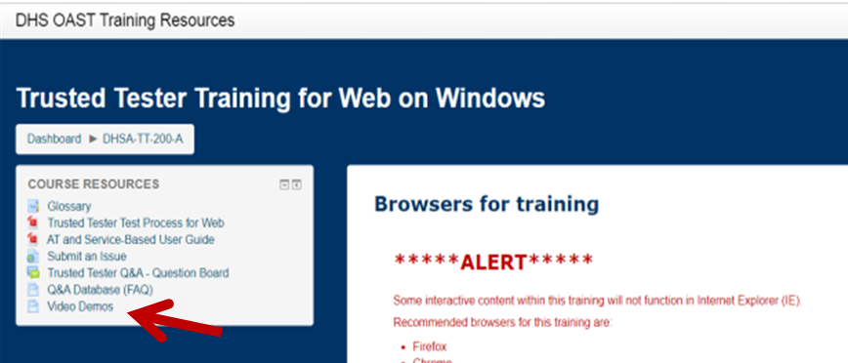
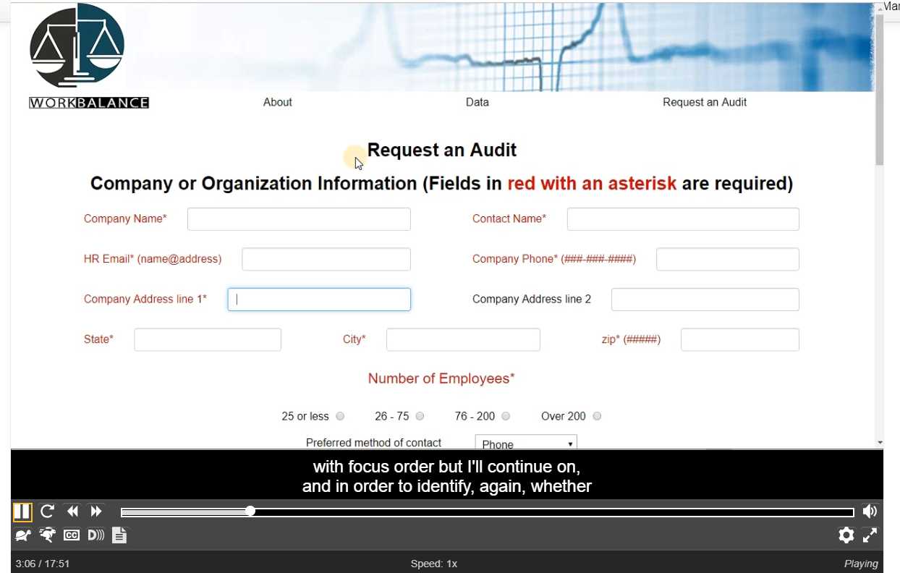
Course Video
Keyboard traps and other keyboard issues are difficult concepts for many students.
The course provides a video demonstrating the testing of the incremental exam page which can be found in the course resources page

Slide 7
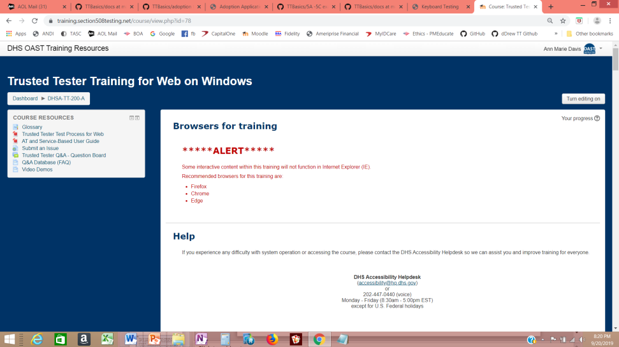
Course Video
Keyboard traps and other keyboard issues are difficult concepts for many students.
The course provides a video demonstrating the testing of the incremental exam page which can be found in the course resources page

Slide 8
4.D 2.4.7-focus-visible
Test Name | Test ID | Test Condition
2.4.7-focus-visible | 4.D | A visible indication of focus is provided when focus is on the interface component.
Evaluate Results:
If the following is TRUE, the content PASSES:
When each interface element receives focus, there is a visible indication of focus.
Tips
Look carefully as there is not a contrast requirement for focus in AA standard – that is AAA.
DO NOT use ANDI for this test since it can add markup that will skew your test results.
Emphasis is on the interactive element.
Does not apply to elements that do not receive keyboard focus. (Those elements are not failed for both 4.A and 4.D.)
Focus indicator is not required to be the same – can be outline, change in hue (though not use of color), making font bold.
Notes:
Need failing and passing examples of visible focus. Passing examples should use multiple methods, such as shading & outline

Slide 9
Notes for Focus with Frames
Note
To confirm keyboard focus is on a frame when there is not visible focus:
Use the TAB and SHIFT + TAB combination to deduce that the keyboard focus is on the frame.
When on the frame, a tab forward should move focus to the first keyboard focusable element within the frame.
From there, SHIFT + TAB once to move back to the frame and another SHIFT + TAB should move focus to a keyboard focusable element before the frame.
Only the frame is permitted to not have a visible focus. Be certain it is the frame that does not have a visible focus and not another element.
Notes:
Need example

Slide 10
4.E 3.2.1-on-focus
Test Name | Test ID | Test Condition
3.2.1-on-focus | 4.E | When an interface component receives focus, it does not initiate an unexpected change of context.
Evaluate Results:
If the following is TRUE, the content PASSES:
An unexpected change of context is not initiated when an interface component receives focus.
Definitions
Change of Content: The page content changes in a way that is expected related to expanding an outline, revealing/hiding content, or accessing a dynamic menu.
Change of Context: There is a major change in content that, if made without user awareness, can disorient users who are not able to view the entire page simultaneously. Examples of a change in context include:
Opening a new browser window.
Moving focus to a different component.
Submitting a form automatically when a component receives focus.
Going to a new web page or window, or appearing to do so.
Significantly rearranging the content of the page.
Notes:
Need passing and failing example

Slide 11
Tips for Focus Order
Tips
Focus on an element should not bring an unexpected change – user needs to select the interface component to initiate the change = a new window is launched, or focus is moved to another interface component.
It is key to understand the difference between a change of content and a change in context. Applying this concept also impacts testing for forms in Topic 5 of the test process.

Slide 12
4.F 2.4.3-focus-order-meaning
Test Name | Test ID | Test Condition
2.4.3-focus-order-meaning | 4.F | The focus order preserves the meaning and operability of the web page.
Evaluate Results:
If the following is TRUE, the content PASSES:
The focus order preserves the meaning of the page, AND
The focus order preserves the operability of the page.
Definition
A modal dialog box (such as a Save As dialog box) requires a user to interact with it before they can go back to the main page. Visual focus is expected to remain within a modal dialog box until it is closed.
Notes:
ANDI tab order markup may be slightly different in certain browsers than a keyboard user’s experience. Always use results from keyboard navigation.

Slide 13
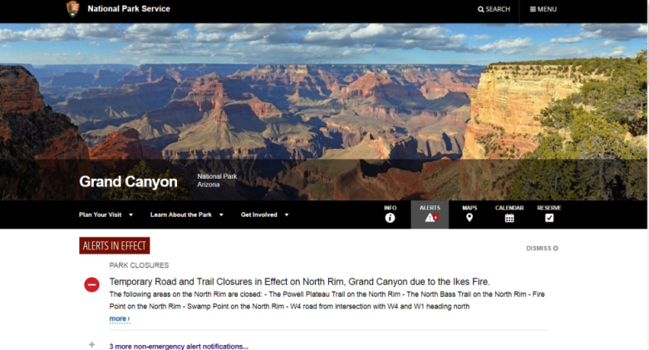
Tips on for Focus
Tips
Failures are most noticeable when focus order does not follow the logical order of operation (normally top to bottom, left to right).
The Focus order can be different if the specific order does not matter
Focus order issues can cause users to become lost:
https://interactiveaccessibility.com/education/training/ex9.1.html#
https://www.nps.gov/grca/index.htm
In the course, you will mark the last item that received the expected focus.

Slide 14
4.H 2.4.3-focus-order-return
Test Name | Test ID | Test Condition
2.4.3-focus-order-return | 4.H | Focus is returned to the logical sequence.
Evaluate Results:
If any the following is TRUE, the content PASSES:
Keyboard focus automatically returns to the logical sequence of focus order before the content was revealed, OR
One additional keystroke or keystroke combination returns focus to the logical sequence of focus order before the content was revealed
Tips:
It may be necessary to Press the SHIFT + TAB keys or an arrow key to move focus backwards.
One additional keystroke is allowed to achieve the expected return of focus.

Slide 15
Content Structure
Topic 10

Slide 16
10.A 2.4.6-heading-purpose
Test Name | Test ID | Test Condition
2.4.6-heading-purpose | 10.A | Each heading describes the topic or purpose of its content.
Evaluate Results:
If the following is TRUE, the content PASSES:
The heading describes the topic or purpose of its content.
Tip:
No tool is required – identify visually apparent headings and review the content beneath them.
Not required to have headings.
Heading tests divided to meet different WCAG success criteria

Slide 17
10.D 1.3.1-list-type
Test Name | Test ID | Test Condition
1.3.1-list-type | 10.D | All visually apparent lists are programmatically identified according to their type.
Evaluate Results:
If ALL of the following are TRUE, then the content PASSES:
All content that has the visual appearance of a list is defined programmatically as a list, according to the type of list.
An unordered list (with or without bullets) is marked as an unordered list (ul).
An ordered list is marked as an ordered list (ol).
Terms and their descriptions that are presented in the form of a list are marked as a description list (dl)
AND
All programmatic list relationships, including nesting and hierarchies, are consistent with the list relationships presented visually.
https://www.w3.org/TR/WCAG20-TECHS/H48.html

